Slide 1
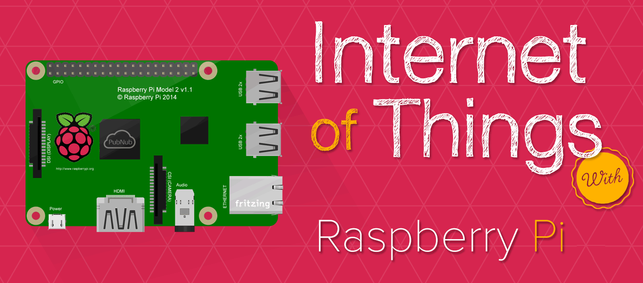

Raspberry Pi

Slide 2
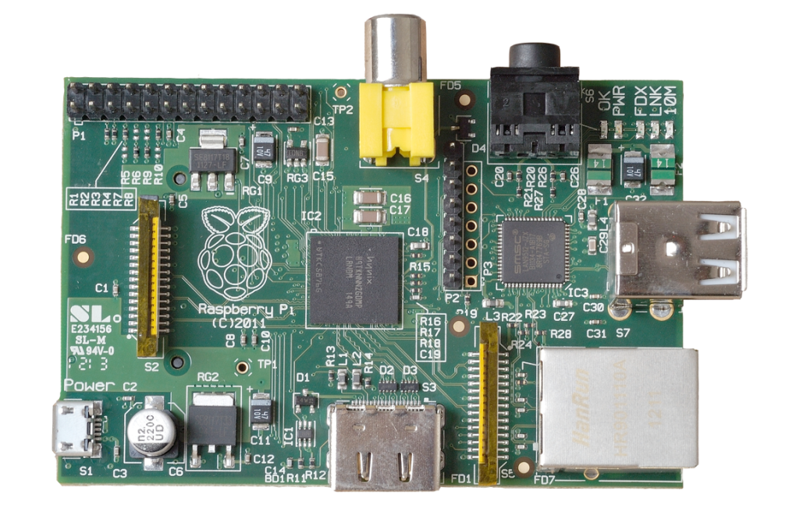
What is a Raspberry Pi?
University of Cambridge’s Computer Laboratory
Decline in skill level
Designed for education
A credit card sized PC
Plugs into a TV or monitor
Inexpensive(ish)
Capability:
Programming
Electronic Projects
Office
Play HD Videos

Slide 3
Kit Components
Essential:
Raspberry Pi board
Prepared Operating System SD Card
USB keyboard
Display (with HDMI)
Power Supply
Highly suggested extras include:
USB mouse
Internet connectivity - LAN cable
Powered USB Hub
Case

Slide 4
SoC in Raspberry Pi: Broadcom
BCM2835 / 2836 / 2837 SoC Multimedia processor
CPU
– ARM 1176JZF-S (armv6k) 700MHz
– RISC Architecture and low power draw
– Not compatible with traditional PC software
GPU
– Broadcom Video IV
– Specialized graphical instruction sets
RAM
– 1GB (Model 2, 3)
– 512MB (Model B rev.2)
– 256 MB (Model A, Model B rev.1)

Slide 5
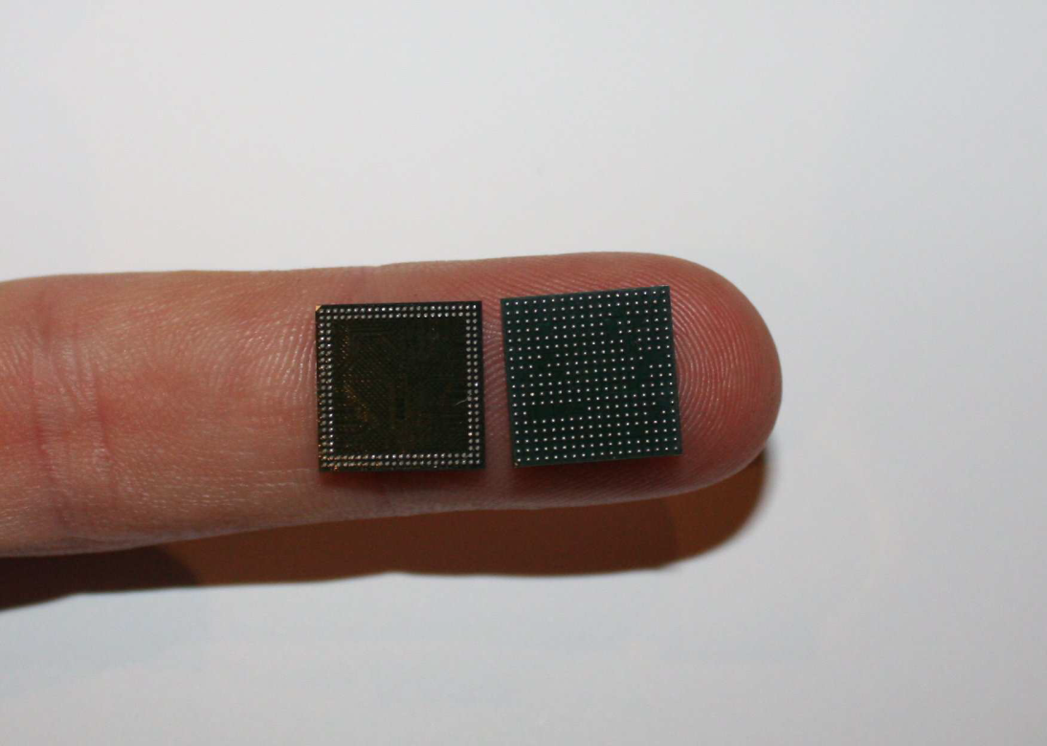
SoC in Raspberry Pi: Broadcom BCM2835 SoC
BCM2835 SoC (right) and Samsung K4P2G324ED Mobile DRAM (left)

Slide 6
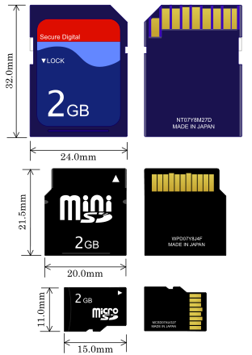
Storage: Secure Digital (SD)
• Form factor
– SD, Mini SD, Micro SD
• Types of Card
– SDSC (SD): 1MB to 2GB
– SDHC: 4GB to 32 GB
– SDXD up to 2TB

Slide 7
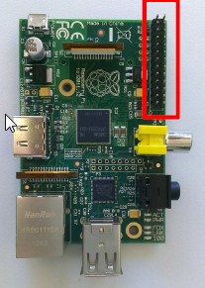
Low Speed Peripherals
General Purpose Input/Output (GPIO)Pins can be configured to be input/output
Reading from various environmental sensors
Ex: IR, temperature, 3-axis accelerometer
Writing output to dc motors, LEDs for status.

Slide 8
Raspberry Pi Setup
1. Download the Raspberry Pi operating system
– Linux releases compatible with the Pi:
http://www.raspberrypi.org/downloads
– The recommended OS is Raspbian:
http://downloads.raspberrypi.org/raspbian_latest
2. Unzip the file that you just downloaded
– Right click on the file and choose “Extract all”.
– Follow the instructions—you will end up with a file ending in .img
Raspberry Pi Setup

Slide 9
3. Download the Win32DiskImager software
– a) Download win32diskimager-binary.zip
(currently version 0.6) from:
https://launchpad.net/win32-imagewriter/+download
– b) Unzip it in the same way you did the Raspbian .zip file
– c) You now have a new folder called win32diskimager-binary

Slide 10
4. Writing Raspbian to the SD card
– a) Plug your SD card into your PC
– b) In the folder you made in step 3(b), run the file named Win32DiskImager.exe
– c) If the SD card (Device) you are using isn’t found automatically then click on the drop down box and select it
– d) In the Image File box, choose the Raspbian .img file that you downloaded
– e) Click Write
– f) After a few minutes you will have an SD card that you can use in your Raspberry Pi

Slide 11
5. Booting your Raspberry Pi for the first time
– On first boot you will come to the Raspi-config window
– Change settings such as timezone and locale if you want
– Finally, select the second choice: expand_rootfs and say ‘yes’ to a reboot
–

Slide 12
Programming Languages
The Raspberry Pi Foundation recommends Python
Any language which will compile for ARMv6 can be used
Installed by default on the Raspberry Pi:
C
C++
Java
Scratch
Ruby

Slide 13
Setup

Slide 14
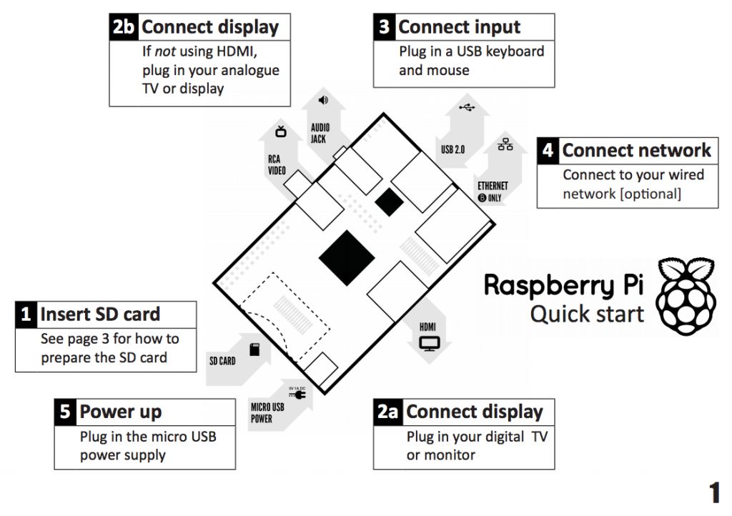

Slide 15
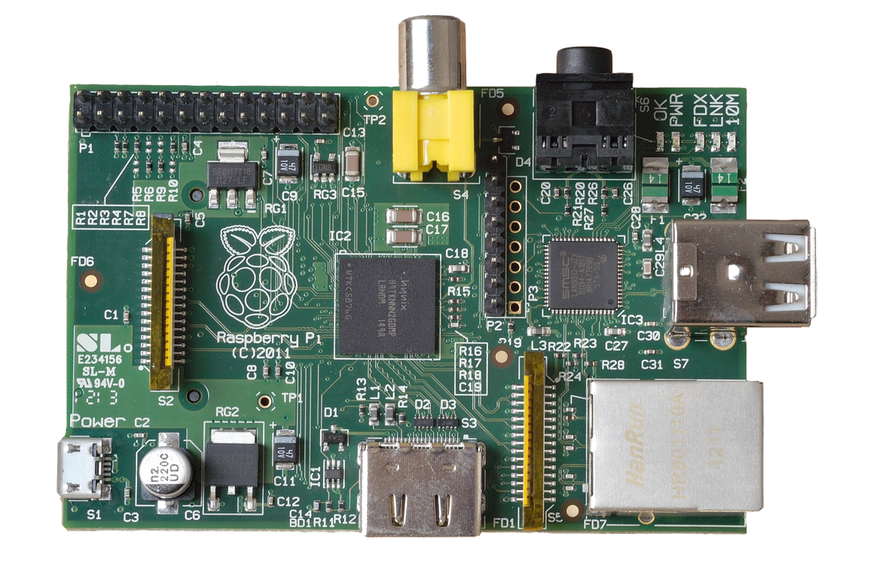
Power
5v micro
USB connector
(Similar to the one on a lot of mobile phones!)

Slide 16
A/V (Audio/Video)
RCA Video
(works with most older TVs)
3.5mm Audio
Standard headphone socket
HDMI Audio & Video
(works with modern TVs and DVI monitors)

Slide 17
Connectivity
2 x USB 2.0
ports
GPIO
(General
Purpose
Input &
Output)
10/100Mb
Ethernet

Slide 18
Internals
LAN Controller
DSI
(display interface)
CSI
(camera interface)
SOC (System On a Chip)
Broadcom BCM2835 700Mhz

Slide 19
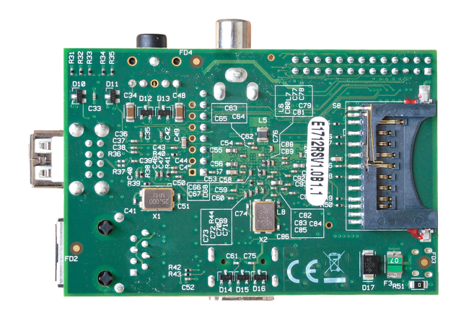
Storage
SD Card Slot
(supports SD cards up to 32GB)

Slide 20
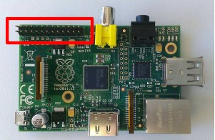
General Purpose Input/Output(GPIO)
General Purpose Input/Output (GPIO) is a generic pin on a chip whose behavior can be controlled by the user at run time.

Slide 21
The GPIO connector has a number of different pins
True GPIO (General Purpose Input Output) pins that you can use to turn LEDs on and off etc.
I2C interface pins that allow you to connect hardware modules with just two control pins
SPI interface with SPI devices, a similar concept to I2C but uses a different standard
Serial Rx and Tx pins for communication with serial peripherals

Slide 22
GPIO pins can be used as both digital outputs and digital inputs.
Output: turn a particular pin HIGH or LOW.
Setting it HIGH sets it to 3.3V; setting it LOW sets it to 0V.
Input: detect the pin being at HIGH or LOW
We can connect switches and simple sensors to a pin and check whether it is open or closed (that is, activated or not)

Slide 23
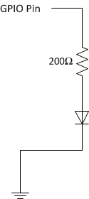
Task 1: Turn LED on for 2 seconds and off for 1 second, loop forever
In this example, we control the LED by controlling the voltage at the anode (+).

Slide 24
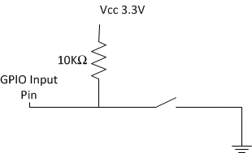
GPIO as Input
• When the switch is not pushed: GPIO detects Vcc (HIGH)
• When the switch is pushed: GPIO detects GND (LOW)

Slide 25


